Slide 1
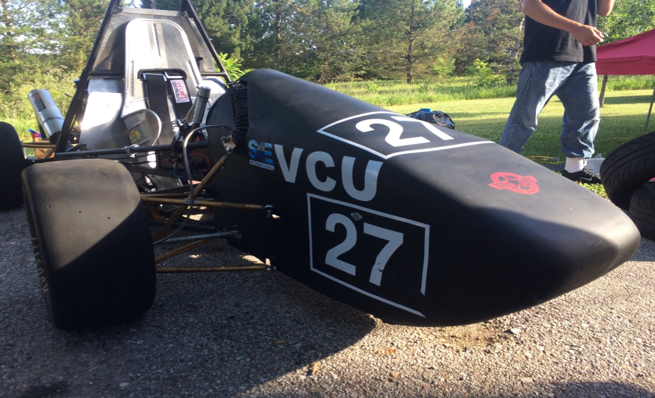
Formula SAE at VCU
VCU-01

Slide 2
Overview
Target Market
Market Overview
Product Details
Marketing and Communication Strategy
Plan for Production

Slide 3
Target Market
Average Joe
25-50 Years old
75k Per year
Loves motorsports
Racing Schools
20-50 Year olds
250k Profits per Year
Bring the car to students

Slide 4
Market Overview
Karting
Modified Car
Open-Wheel Racecars

Slide 5
VCU-01
Affordable
Easy to maintain
High Performance

Slide 6
Product Details
85BHP @ 12000 RPM
0-60 MPH in 3.2 Seconds
50-70 MPG
5 Point Racing Harness

Slide 7
Marketing & Communication Strategy
3 Main Marketing Strategy
Community Events
Social Media
Facebook
Instagram
Twitter
Android/IOS Application

Slide 8
Production Facility
35000 Sqr Ft
Hand built
30-40 Employees

Slide 9
Production
Production targeted for fleet sales
Producing 250 Units Per year
Production with Various Packages

Slide 10
Pricing
Produced for $15,000
Selling at $17,000 for Base Model
Discounted package pricing for fleet sales

Slide 11
Packages
Upgraded tech
Digital tach
Shift lights
Megasquirt ECU
45% Lighter Rims
Carbon Fiber Intake

Slide 12
Summary
High Performance Low cost Vehicle
Easily Maintainable
Super Reliable

